Slide 1
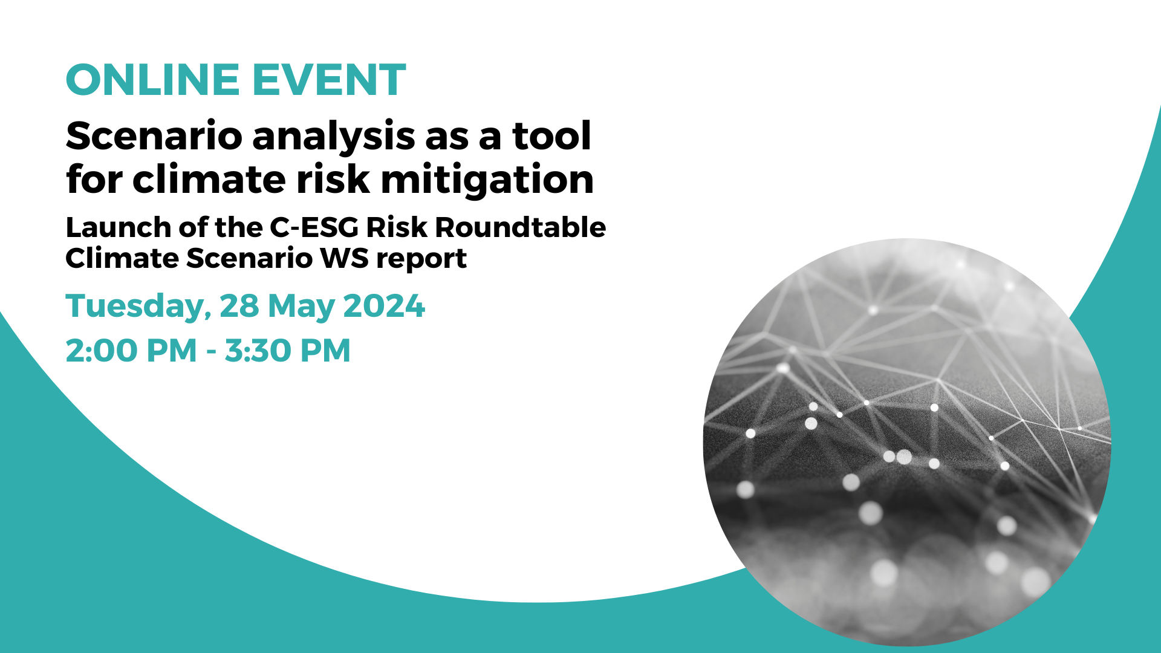

Slide 2
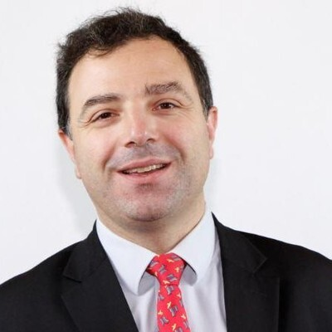


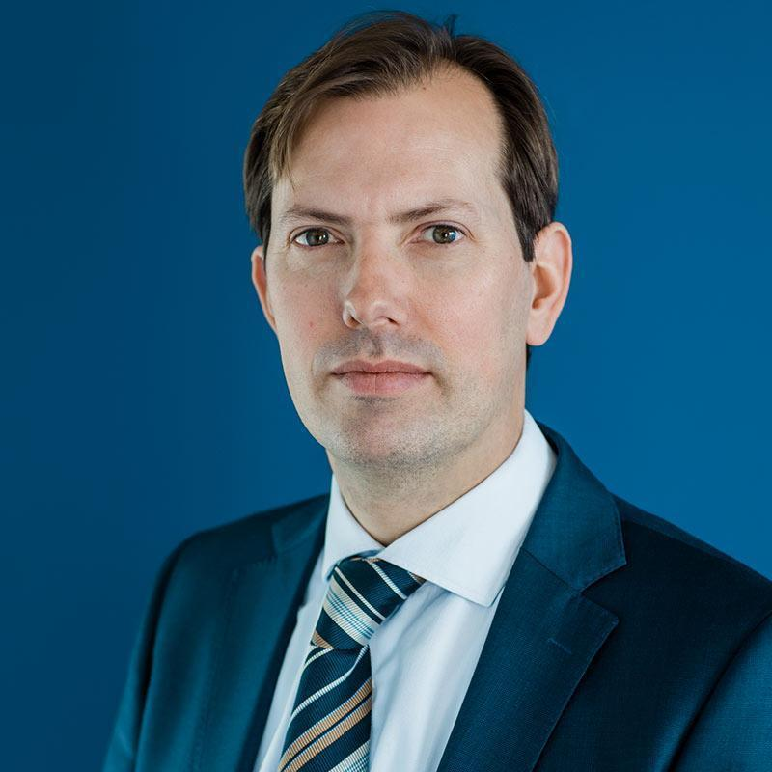

Speakers
Moderator
Marc Irubetagoyena
Head of Group Stress Testing and Financial Simulations
BNP Paribas
Djean Ba Lou
Lead Supervisor
European Central Bank
Denisa Avermaete
Senior Policy Adviser - Sustainable Finance,
European Banking Federation
Angel Monzon
Head of Risk Analysis and Stress Testing
European Banking Authority
Nicola Morandin
Head of Credit & Climate Stress Testing
Unicredit

Slide 3

Report of the C-ESG Risk Roundtable Climate Scenario Workstream
Presentation of the Report
Marc Irubetagoyena
Head of Group Stress Testing
and Financial Simulations
BNP Paribas
Report of the C-ESG Risk Roundtable Collateral Workstream
Presentation of the Report
Monica López-Monís, Head of Supervisory and Regulatory Relations, Santander Group
11 January 2024

Slide 4

A collaborative work on climate scenario analysis
A collaborative work of the Climate Scenario Analysis WorkStream (CSA WS) has been facilitated by BNP Paribas, with the participation of the ECB and the EBF in an observing capacity.
CSA WS objectives are to share between participating banks:
the current practices on Climate and ESG scenario analysis,
targeted evolutions on Climate and ESG scenario analysis,
internal capital assessment and risk materiality analysis.
The initial focus is on Climate and Environmental risk factors.
Understanding of common building blocks as well as discrepancies, identification of clear challenges with proposed short-term solutions, public dissemination of observed practices are the expected deliverables of the CSA WS.

Slide 5
Key learnings on CSA from this first year of joint work
Climate scenario analysis is on the rise for key risk and strategic processes, as shown by the numerous supervisory exercises and in the publications of the banks.
CSA is a relevant tool for climate risk assessment and communication notably due to:
the transparency on hypothesis retained in the scenarios played,
some consistency (to be enhanced) in the methodology used,
long-term practice of data gathering aligned with prudential and accounting reporting.
With some prerequisites, disclosing CSA based on a set of anchor climate scenarios could meaningfully complement the already wide range of financial institutions’ disclosures (among which the alignment of their portfolios with a Net Zero 2050 scenario for NZBA banks).

Slide 6
Main prerequisites for relevant CSA
-the availability of detailed data to describe current exposure to risk factors and its evolution in the past to capture dependencies between climate transmission channels and banking financial risks;
-the ability to produce or enrich external climate reference scenarios scientifically credible (Institut de l’Energie Atomique or Network for Greening the Financial System);
-the ability to identify the material climate risk factors for the institution and the portfolio areas most exposed to these risk factors with their associated transmission channels towards financial risks of the institution;
-the formalisation of the evolution of the institution’s strategy in the various climate scenarios in order to project the deformation of the balance sheet and in particular its exposure to the different types of clients and locations, as well as the financed emissions;
-the modelling of the impacts of climate risk factors, through relevant transmission channels, on the financial risks of institutions;
-Communication packs adapted to the different targeted audiences (clients, supervisors, investors, associations, lobbyists, general public,…).

Slide 7
Map of Climate FactSheets (CFS)
CFS2- Climate risk identification and transmission channel selection
CFS3- Climate data concerns
CFS1- Climate scenario design
CFS4 to 6- Climate insertion in risk modelling (credit risk, market and counterparty risks, operational and business risks)
CFS7- Climate insertion in strategic processes
Climate Scenario FactSheets yearly updated with latest enhancements
First version of Climate Scenario Factsheets is shared, with an updated version yearly.
A version for biodiversity and other environmental risk factors will be prepared by the end of 2024.
Feedback
loop

Slide 8
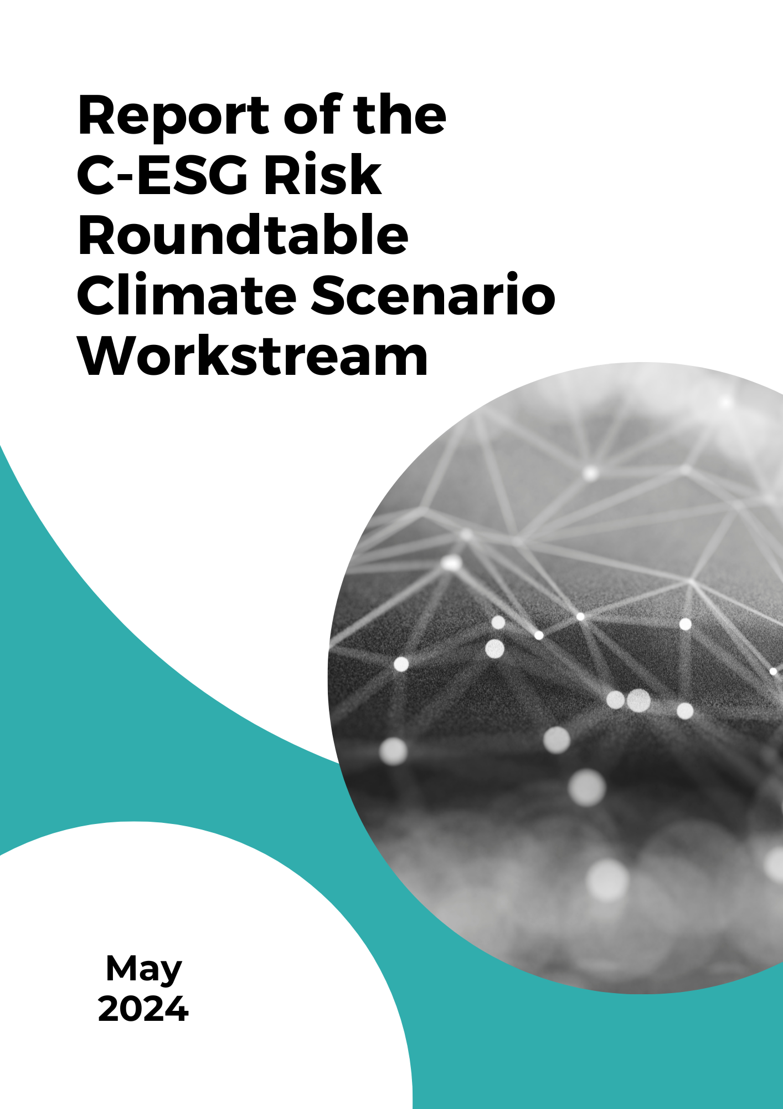
THANK YOU FOR JOINING US!
The recording of this event
will be available tomorrow!
THE REPORT IS NOW
AVAILABLE!

